Slide 1
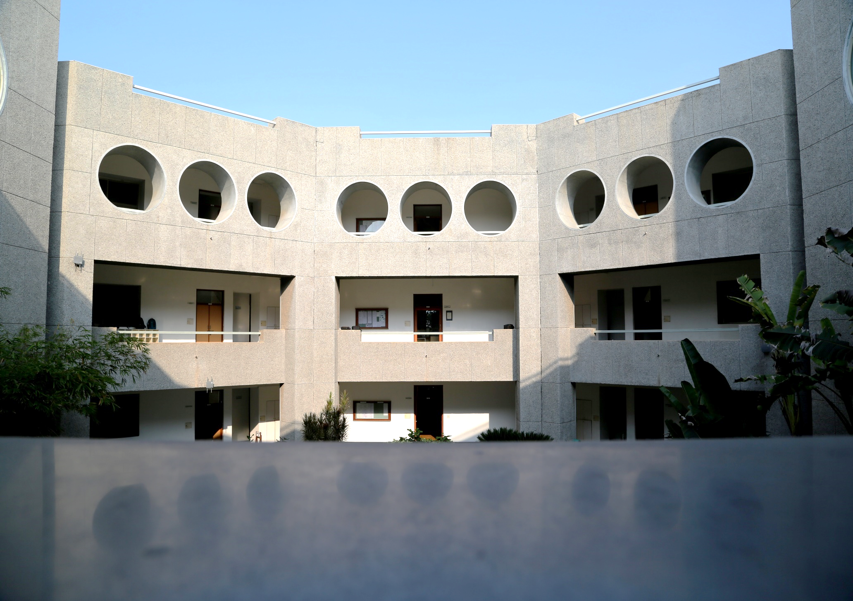
Institute of Pharmacy
Internal Quality Assurance Cell (IQAC)
Vision
To ensure quality culture as the prime concern for the Higher Education Institutions through institutionalizing and internalizing all the initiatives taken with internal and external support.
Objectives
To develop a system for conscious, consistent and catalytic action to improve the academic and administrative performance of the institution.
To promote measures for institutional functioning towards quality enhancement through internalization of quality culture and institutionalization of best practices.
Strategies
IQAC shall evolve mechanisms and procedures for
Ensuring timely, efficient and progressive performance of academic, administrative and financial tasks;
Relevant and quality academic/ research programmes;
Equitable access to and affordability of academic programmes for various sections of society;
Optimization and integration of modern methods of teaching and learning;
The credibility of assessment and evaluation process;
Ensuring the adequacy, maintenance and proper allocation of support structure and services;
Sharing of research findings and networking with other institutions in India and abroad.

Slide 2
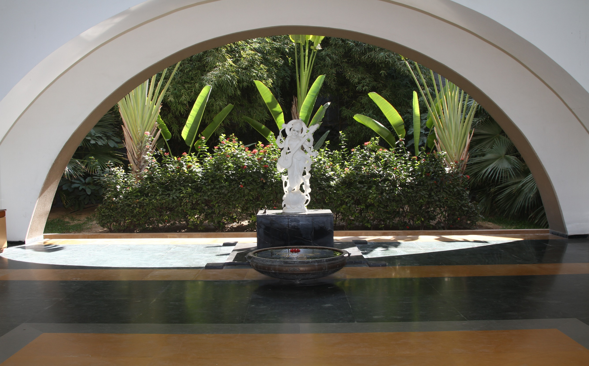
Institute of Pharmacy
Internal Quality Assurance Cell (IQAC)
Functions
Development and application of quality benchmarks.
Parameters for various academic and administrative activities of institution.
Facilitating the creation of a learner-centric environment conducive to quality education and faculty maturation to adopt the required knowledge and technology for participatory teaching and learning process.
Collection and analysis of feedback from all stakeholders on quality-related institutional processes.
Dissemination of information on various quality parameters to all stakeholders.
Organization of inter and intra institutional workshops, seminars on quality related themes and promotion of quality circles.
Documentation of the various programmes/activities leading to quality improvement.
Acting as a nodal agency of the Institution for coordinating quality-related activities, including adoption and dissemination of best practices.
Development and maintenance of institutional database through MIS for the purpose of maintaining /enhancing the institutional quality.
Periodical conduct of Academic and Administrative Audit and its follow-up
Preparation and submission of the Annual Quality Assurance Report (AQAR) as per guidelines and parameters of NAAC.

Slide 3
Institute of Pharmacy
Composition of IQAC- I
Chairperson | Prof. Dr. Gopal Natesan, Director
Coordinator | Prof. Jigna Shah, HOD, Dept. of Pharmacology
University Representative | Shri G. R. Nair Executive Registrar, NU
Administrative Officers | Prof. Tejal Mehta, HOD, Dept. of Pharmaceutics
Administrative Officers | Prof. Priti Mehta, HOD, Dept. of Pharm. Analysis
 | Dr. Hardik Bhatt, HOD, Dept. of Pharm. Chemistry
 | Dr. Niyati Acharya, HOD, Dept. of Pharmacognosy
 | Ms. Telgy James, Office Superintendent
 | Ms. Mrugani Surati, Assistant Manager, Corporate Relations
 | Mr. Virendra Goswami, I/C Librarian
Member Secretary Nominated by HoI | Dr. Nagja Tripathi, Assistant Professor, Pharmacognosy
Faculty Members | Dr. Mayur Patel Dr. Shital Butani Dr. Shital Panchal Dr. Snehal Patel Dr. Vivek Vyas Dr. Mohit Shah
Alumni Representative | Dr. Ankit Parikh
Industry Representative | Dr. Manan Shah
Student Representatives | Mr. Manmohan Sharma Ms. Lajja Patel Ms. Srashti Verma

