Slide 1
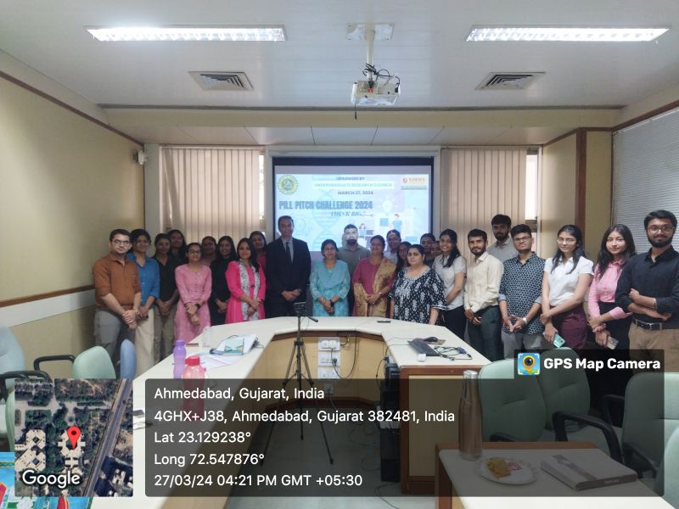
Pill Pitch Challenge 2024
This competition was designed to address the fundamental aspect of research: the formulation of innovative research or start-up concepts. Dr. Bhagwati Saxena, Event Coordinator and UGRC member, along with Dr. Bhumika Patel, UGRC Coordinator, extended invitations to aspiring participants.
A total of 16 teams, i.e., 32 students, enthusiastically participated in the competition, presenting their ideas across five research scopes: Wet Lab-based, Marketing/Survey-based, Prototype/Model Making, Start-up Ventures, and App Development. Each team showcased their ideas with commendable proficiency.
The esteemed Dr. Iti Gupta, Associate Professor at the Indian Institute of Technology, Gandhinagar, graciously consented to serve as the expert evaluator for the student pitches. Following a rigorous assessment, it gives us great pleasure to announce the victors of the Pill Pitch Challenge 2024.
The winning teams have been granted seed funding to materialize their innovative ideas into practical ventures.

