Slide 1
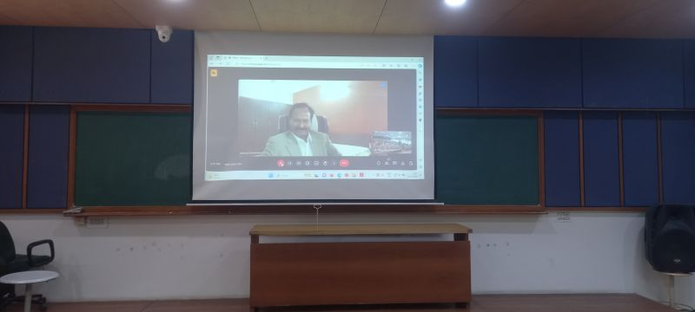
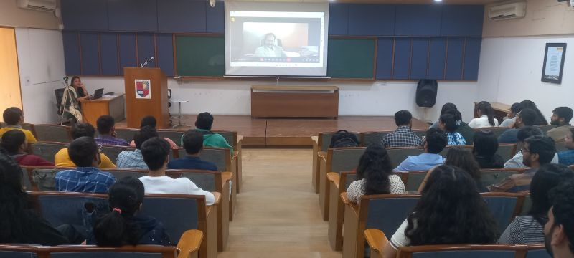
The UG Research Council (UGRC) at the Institute of Pharmacy successfully hosted an online expert session on January 18, 2024
Dr. Brijesh Srivastava,
Retired GM
Medicinal Chemistry Department Zydus Research Centre, Ahmedabad
The session, held on January 18, 2024, focused on "The Role & Importance of Research in Drug Discovery and Development" and catered to UGRC Students of BPharm Semester VI and Post-graduate in Pharmacy students. Dr. Brijesh provided valuable insights on stepwise drug discovery process and presented a case study of drug discovery leading up to INDA submission.

Slide 2
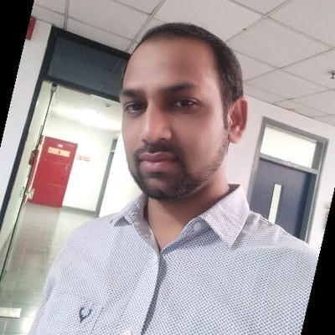
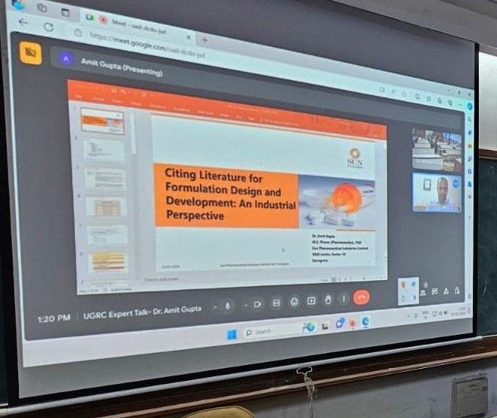
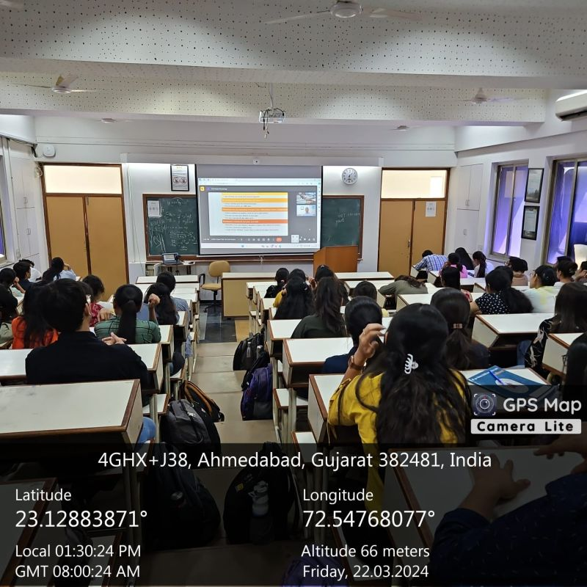
Undergraduate Research Council (UGRC), Institute of Pharmacy, Nirma University hosted an engaging online session on March 22, 2024
Dr. Amit Gupta
Research Manager
Sun Pharmaceutical Industries Ltd.,
Gurgaon
Dr. Amit Gupta discussed on "Citing Literature for Formulation Design and Development: An Industrial Perspective". Dr. Gupta's presentation delved into the critical evaluation of academic books, research papers, patents, and more, offering valuable insights into literature review tactics and drafting techniques for citing literature. This stimulating lecture has inspired budding researchers to explore new horizons in pharmaceutical sciences, equipping them with the tools to enhance their literature search, topic selection, and citation skills.

Slide 3
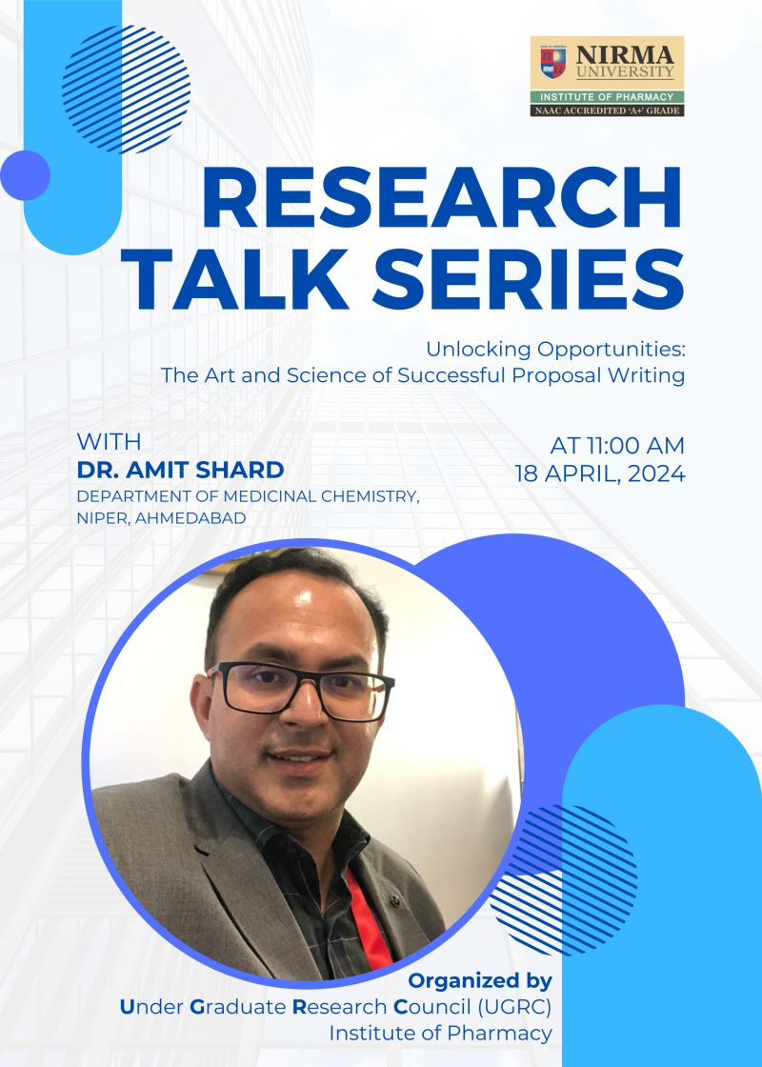
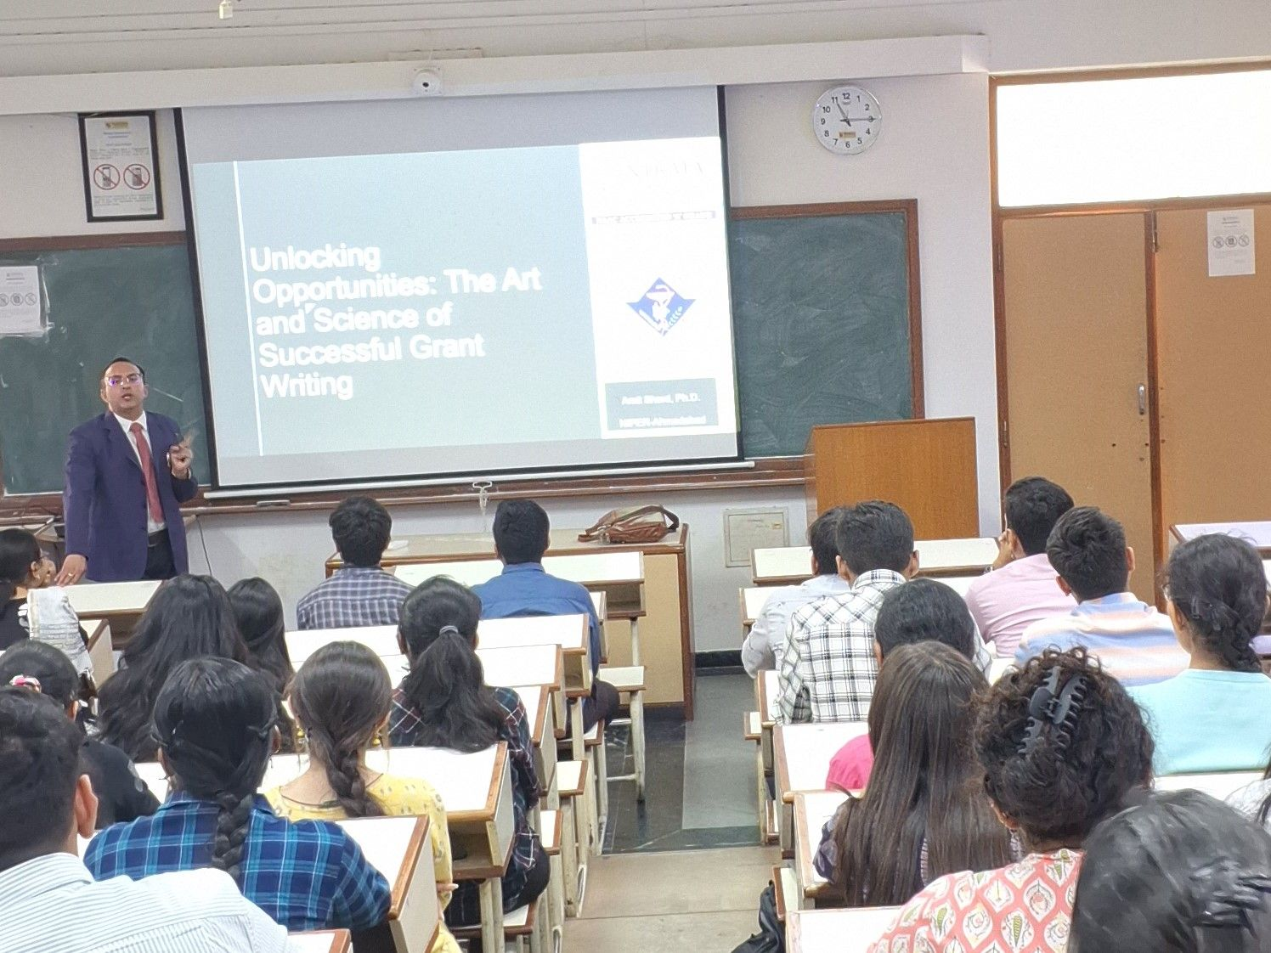
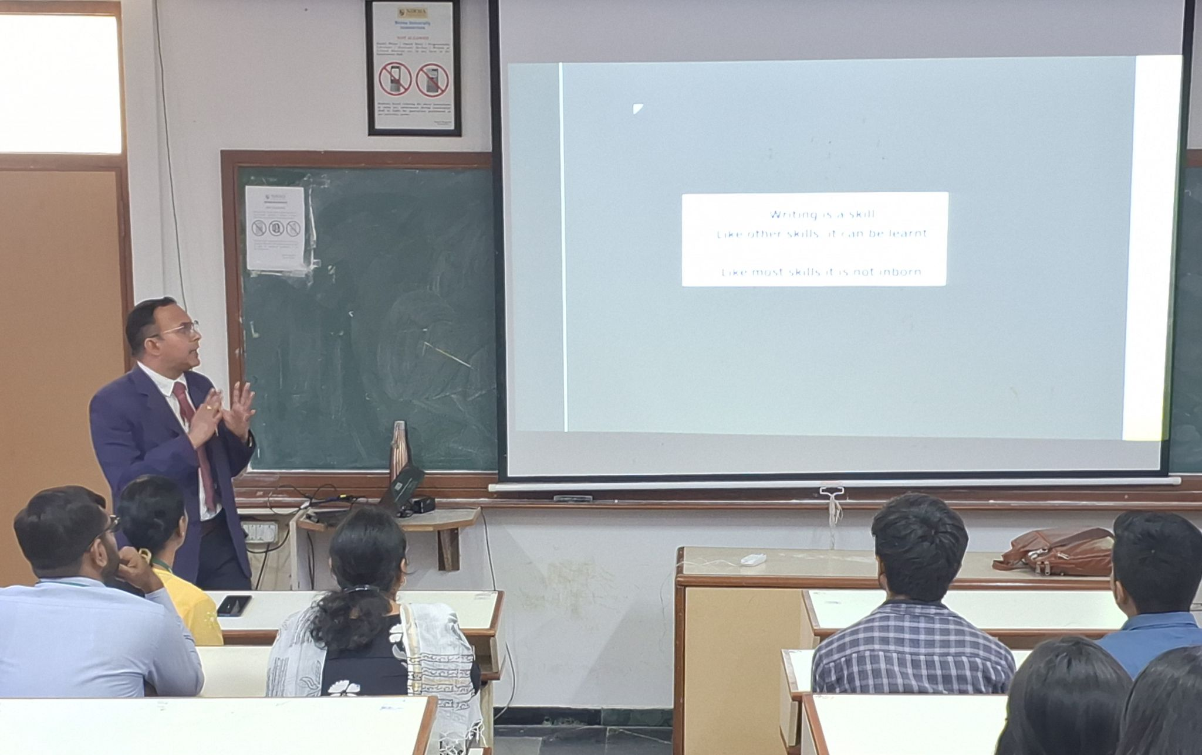
The UG Research Council (UGRC) at the Institute of Pharmacy, Nirma University, hosted a Research Talk on 18-April-2024
Dr. Amit Shard,
Assistant Professor at the
National Institute of Pharmaceutical Education and Research (NIPER)-Ahmedabad,
The session focused on "Unlocking Opportunities: The Art and Science of Successful Proposal Writing" and was aimed at undergraduate students enrolled in UGRC, post graduate students and Faculty Members. Dr. Amit Shard delved into various aspects of proposal writing, offering insights and strategies.

