Slide 1
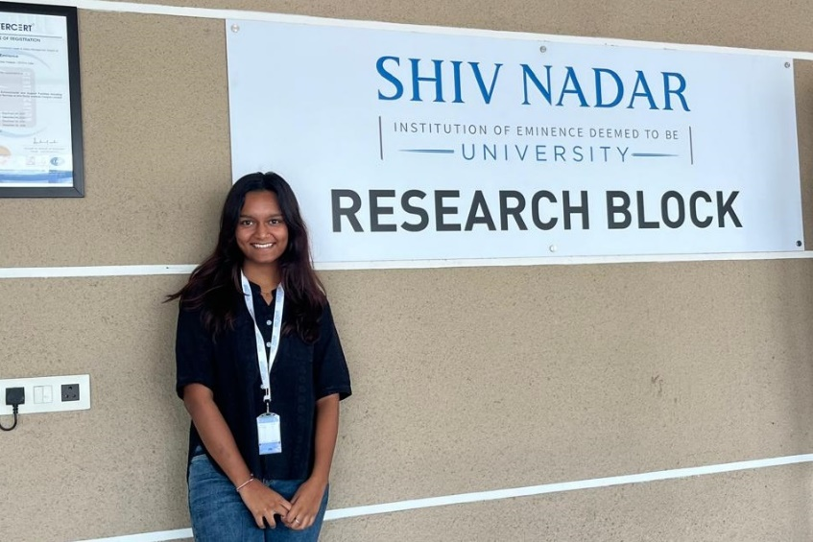
SUMMER TRAINING PROGRAMS
Ms. Hely Shah (21BPH037) received and completed the IASc-INSA-NASI Summer Research Fellowship 2024 at Shiv Nadar University, Tehsil Dadri during June-July 2024.
She conducted research on the synthesis, characterization, and crystal structure of pharmaceutically active compounds under the guidance of Professor Parthapratim Munshi from the Department of Chemistry at the School of Natural Sciences, Shiv Nadar Institute of Eminence, Greater Noida. Her research focused on a compound used in the treatment of African sleeping sickness, and this achievement will greatly bolster her future research efforts.
3 more students applied for the International Summer Training Programme 2024 but unfortunately could not secure.
Trasadiya Smeet (21bph115) applied at Cold Spring Harbor Laboratory
Amin Maan (21BPH054) applied at Cold Spring Harbor Laboratory and NUS Amgen Scholars Asia Program 2024
Arya Acharya (21BPH010) applied at Khorana Program for Scholars – 2024

Slide 2
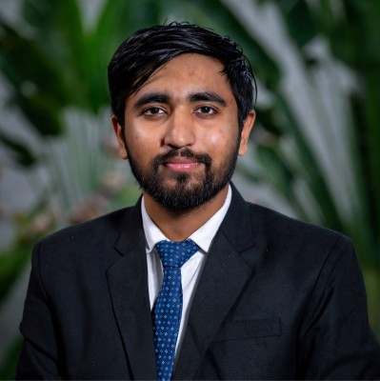
Projects supported under Incubation scheme
Business idea of Mr. Smeet Trasadiya (21BPH115) entitled “Hot Bag for instant food-making” has been selected under the SSIP 2.0 scheme for incubation support at the Nirma University incubation centre on June 6, 2024. The objective of idea is to get instant hot cooked food within minutes without electricity and gas. It is designed for Travelling and Mountaineer.

Slide 3
Publications
Journal Publications
Soni M, Tulsian K, Barot P, Vyas VK. Recent Advances in Therapeutic Approaches Against Ebola Virus Infection. Recent Advances in Anti-Infective Drug Discovery Formerly Recent Patents on Anti-Infective Drug Discovery. 2024 Nov 1;19(4):276-99 (https://pubmed.ncbi.nlm.nih.gov/38279760/)
Maheshwari, Sonali, and Bhoomika M. Patel. "Unravelling the role of cathepsins in cardiovascular diseases." Molecular Biology Reports 51.1 (2024): 579 (https://pubmed.ncbi.nlm.nih.gov/38668953/)
Shah D, Gajjar D, Kapadia D, Danayak V, Soni R, Patel Y, Patel M, Shah JS. Prevalence of Patient Awareness and Compliance in T2D Patients in the Urban Ahmedabad Region: A Retrospective and Prospective Study. Clinical Diabetology. 2024 Aug 19. (https://journals.viamedica.pl/clinical_diabetology/article/view/100771)
Book Chapter:
Aabir Pramanik, Sonali Maheshwari, and Niyati Acharya. “Medicinal Plants, Antioxidant Potential and Applications to Aging” in Role of Herbal Medicines, Management of Lifestyle Diseases 2024, Ed Amal Kumar Dhara & Subhash C. Mandal, March 2024, 403-414, eBook ISBN 978-981-99-7703-1, Print ISBN 978-981-99-7702-4, Springer, Singapore. (https://doi.org/10.1007/978-981-99-7703-1_20)

